Slide 1
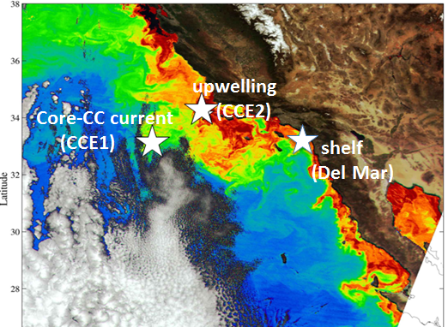
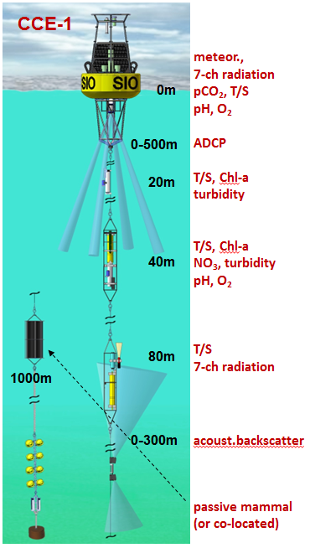
Multi-disciplinary real-time moorings
many disciplines
multi-PI (Send, Ohman, Martz, Demer)
multi-institution (SIO, PMEL, SWFSC, UCSB)
co-funded by several NOAA line offices
real-time and remote control
expandable, high payload,
can accommodate nearly any sensors
Notes:
An example of the highly capable moorings we have developed and operate with NOAA funding, carrying a wide range of sensors. Water depths at the deployment locations range from 100m to 4000m. All sensors, all the way to the seafloor, can be remotely accessed, and data get telemetered daily.

Slide 2
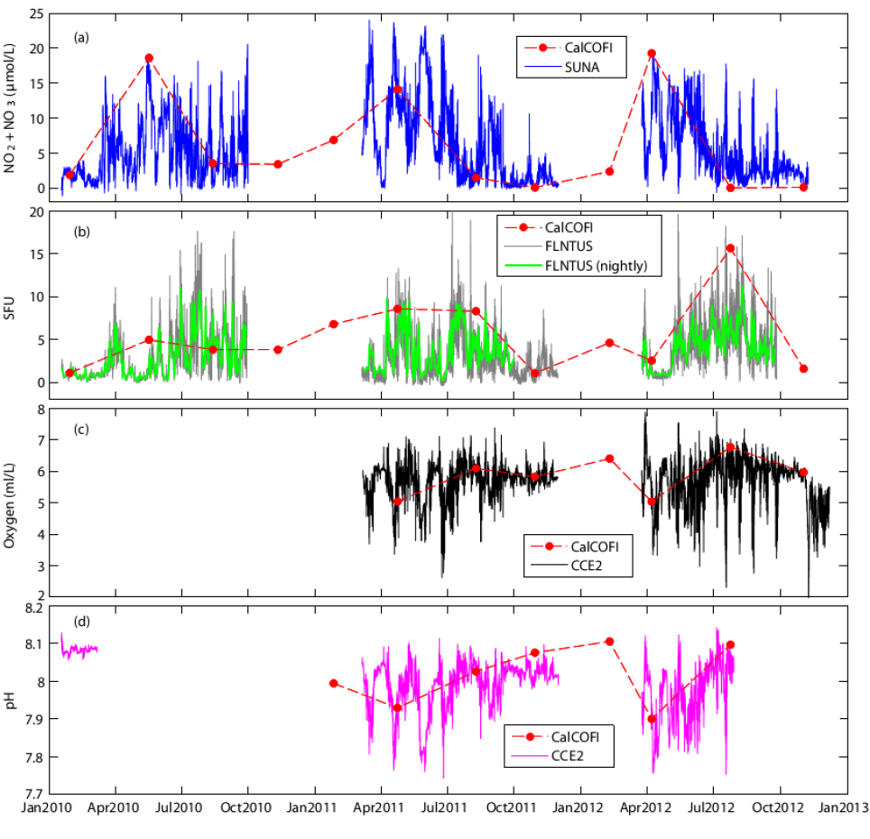
Information content of continuous autonomous timeseries
NO₃
some autonomous sensors can now give data comparable to ship sampling.
Continuous measurements from moorings are an important complement to occasional sampling from ships.
Timescales:
- Diurnal and tidal (1 day)
- Upwelling/mixing events (1 week)
- Changes in source water masses
(months to a year)
- Climate variability, e.g. ENSO,
NPGO, warm anomaly (multi-year)
Chl fluorescence
oxygen
pH
Notes:
Examples for four different variables which we can now observe continuously from moorings (colored lines), compared with quarterly water sampling/analysis using ships (red dots). Even glider sections, which have a typical repeat cycle of several weeks, cannot observe much of the actual variability and would thus alias the results or miss events and extremes.

Slide 3
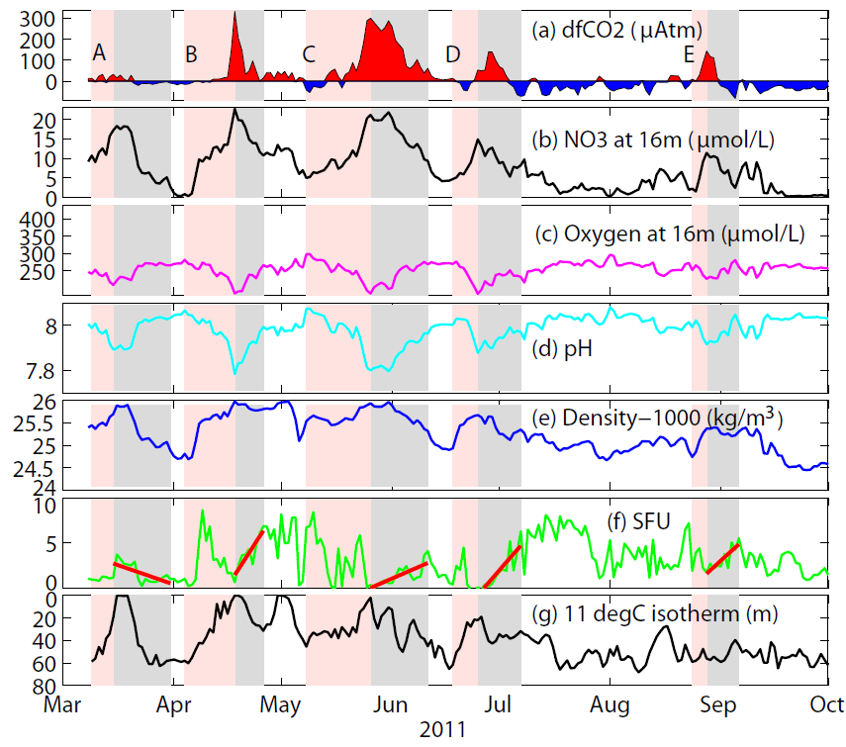
Upwelling events and plankton blooms
2011
CO₂
NO₃
O₂
pH
density
Chl fluorescence
isotherm depth
Notes:
Real-time data from one of our moorings in the upwelling region off southern California, showing several sequences of upwelling (pink) and so-called relaxation events (gray), from the physical forcing to biogeochemical and biological impacts (see zoom in next slide)

Slide 4
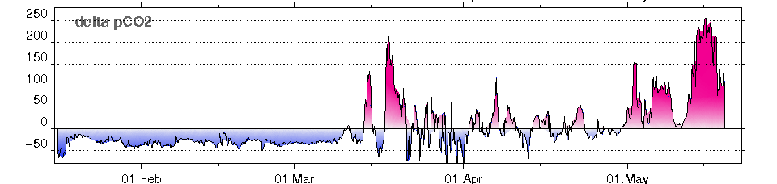
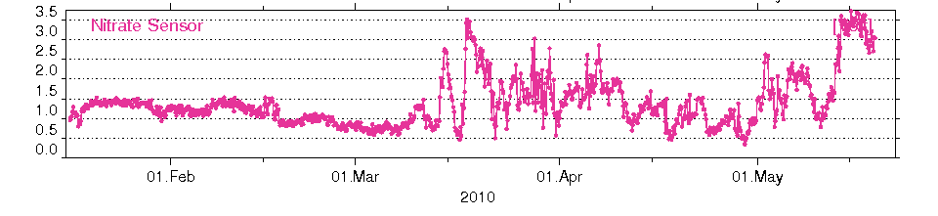
Example for sequence of events directly observed
Detailed processes during upwelling events visible with moorings:
1: Upwelling
brings low
pH/high CO₂
and nutrients
to surface
(CCE-2 real-time data example)
3: Bloom draws
down CO₂
2: nutrients
cause bloom
Notes:
Detailed view of one upwelling event, showing how the injection of nutrients into the surface layer causes a bloom, which then draws down the CO2 again. We are working on detailed carbon budgets based on such observations.

Slide 5
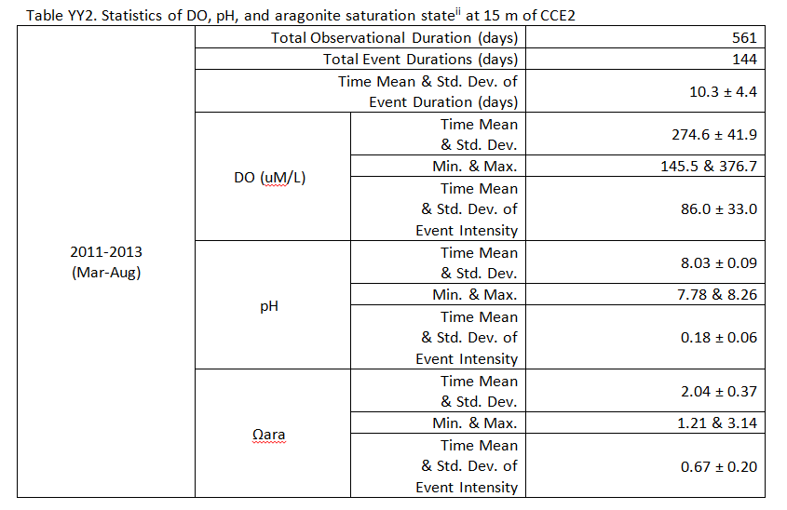
Statistics of upwelling events (3 years) at CCE2, 15m
DO (μM/L)
pH
Ω_{arag}

Slide 6
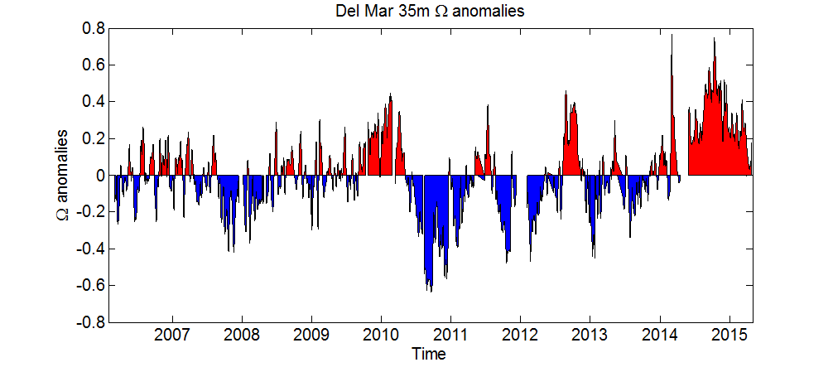
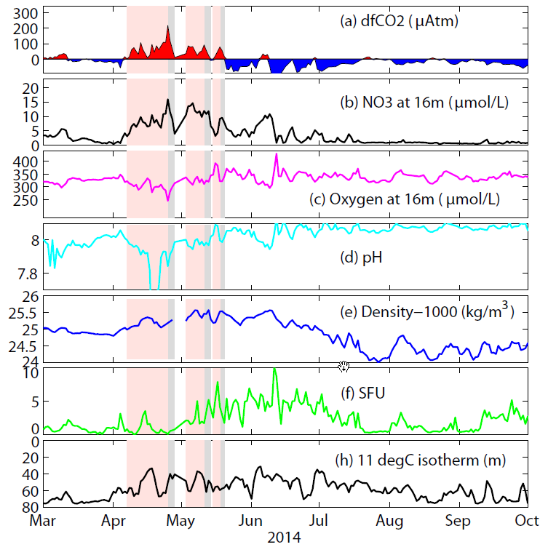
The 2014 warm anomaly: biogeochemical/ecosystem changes
Del Mar 35m
La Niña
Interannual changes in pH and Ω_{arag}
2014 warm
anomaly
2011
Big change in nutrients (nitrate)
➔ very low productivity
2014

Slide 7
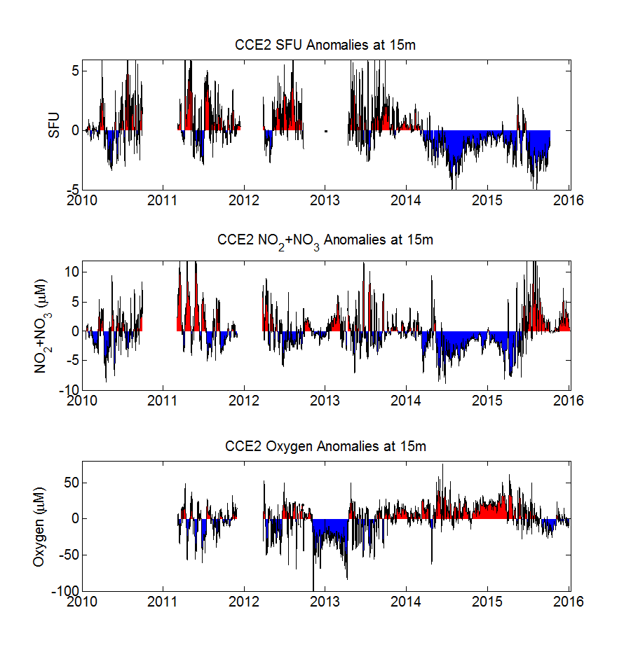
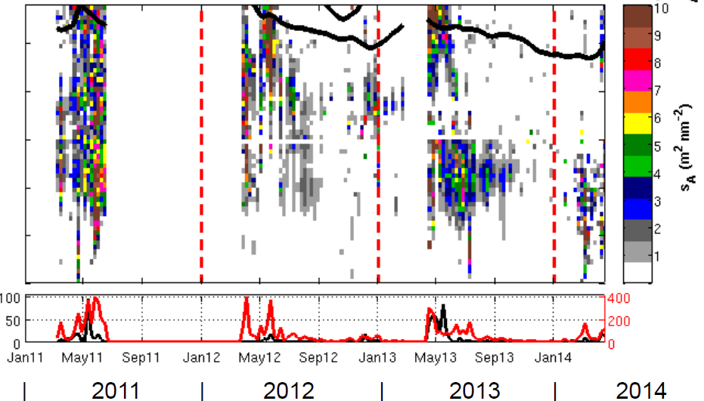
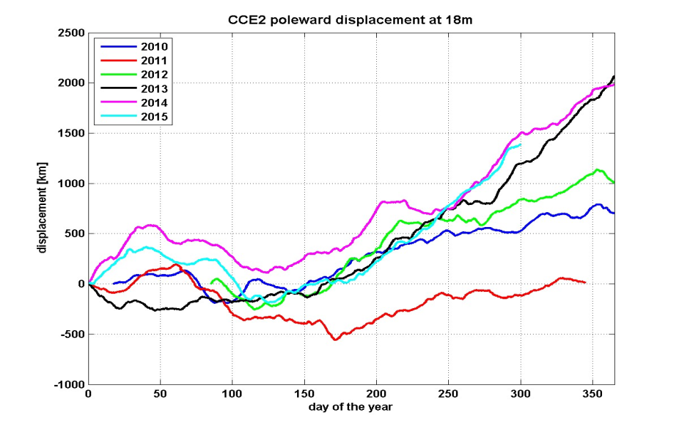
Anomalies in 2012-2015
15m anomalies at CCE2 mooring
SFU
NO₃
O₂
Moorings have detected unprecedented anomalies and directly observe the processes leading to them.
Acoustic fish observations:
shift from sardine to deeper species in 2012
Along-coast current displacements
New capabilities under way:
→ genomic sensors and acoustic fish tollgates
Notes:
Our moorings shown in the map have captured the well-publicized warm anomaly of 2014/15 also in chlorophyll (SFU), nitrate nutrients, and oxygen. Biologists have found zooplankton species which can ONLY have been carried by unusual currents from far south off Mexico. Our current measurements show anomalous northward along-coast flow in 2014/15, but also already in 2013. This matches acoustic fish observation on our moorings (using simpler single-frequency acoustic backscatter instruments) which show a shift to different and deeper species starting in 2013.

Slide 8
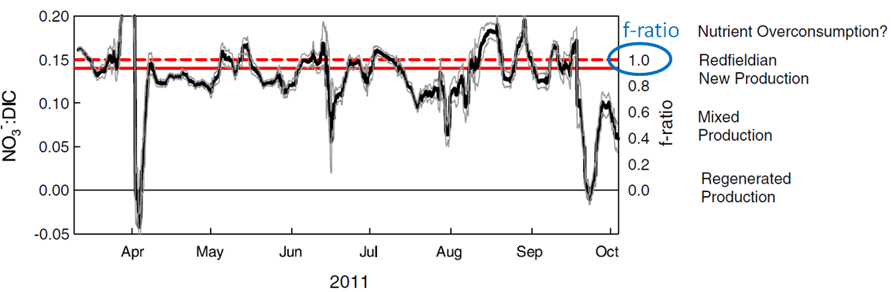
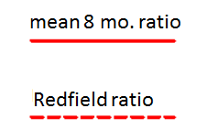
Dynamic variability of elemental ratios: new production
Can estimate uptake and remineralization ratios from high-passed sensor data.
(Martz et al, 2014)
mean is close to traditional Redfield Ratios, but large daily to weekly changes
suggests regime shifts between Redfieldian New Production, Regenerated Production, and Nutrient Overconsumption.

Slide 9
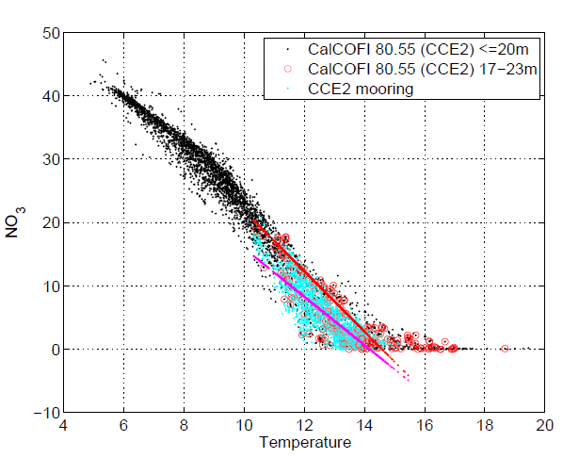
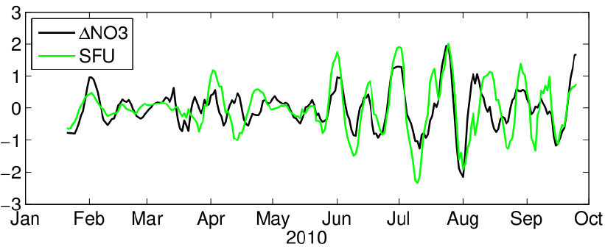
Nutrient/chlorophyll budgets for upwelling events
Infer NO₃ of freshly upwelled water from temperature (not changing fast)
By the time water arrives at CCE2 mooring NO₃ has been used→ deficit/usage
bandpassed
quantitative relation between “used” nutrients and created phytoplankton

Slide 10
Carbon budgets for upwelling events
Use density to infer DIC of freshly upwelled water, and compare to actual DIC
Difference on event timescales is due to air-sea flux and Net Community Production (NCP).
Doing the same for oxygen gives another estimate for NCP → consistency check
Full budgets (on longer timescales and away from active upwelling) requires spatial gradients for advection estimates:
$$\frac{∆X}{dt}={\left(f_{gas}+f_{ent}+f_{diff}+f_{adv}+f_{u/r}+f_{NCM}\right)}/{MLD}$$

